Slide 1
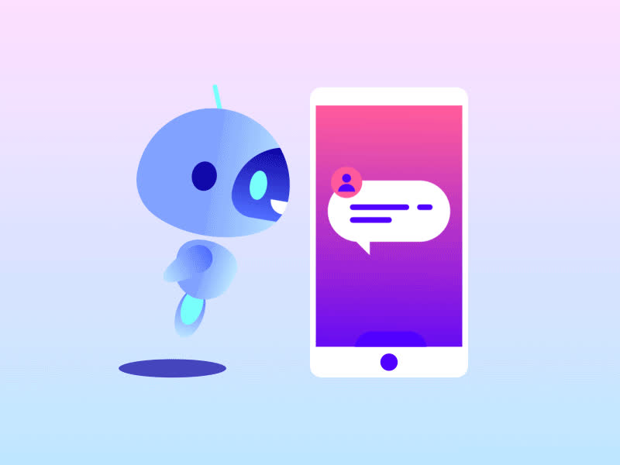

CSE Department Chatbot
Mini Project for CSE Department
Anushka Negi
[B.Tech CSE (III - Sem)]
Section: K1
University Roll No: 2318473
[Graphic Era Hill University Dehradun]

Slide 2


Problem Statement
Problem: CSE students face difficulties in accessing relevant information quickly, leading to delays in their academic journey.
Issues Identified:
• FAQs: Repetitive questions like "When is the next exam?" or "How do I register for courses?" often burden faculty and staff.
•Time-Related Issues: Students lose time waiting for responses and can’t get immediate answers for urgent queries.
• Access to Resources: Difficulty in finding the right resources for assignments, exam preparation, etc.
• Limited Personalization: Standard solutions often fail to address student-specific concerns or queries.
A solution is needed to provide instant, accurate, and accessible information for the department.

Slide 3
Objectives
The CSE Department Chatbot is an Artificial Intelligence-based virtual assistant designed to enhance and simplify communication within the department. It provides instant responses to queries related to various aspects of the department, such as faculty details, placements, syllabus, lab facilities, events, and more.This chatbot demonstrates the effective use of Natural Language Processing (NLP) and Machine Learning (ML) techniques to create an interactive tool. By automating the process of answering frequently asked questions, the chatbot saves time and reduces the workload on administrative staff. It is designed to integrate seamlessly into departmental operations, offering students and faculty a user-friendly platform for obtaining information.
Automate student queries related to CSE department
Enhance student experience by providing real-time, accurate information
Reduce administrative workload
Improve accessibility and usability
By automating repetitive tasks like answering FAQs, the chatbot reduces the burden on administrative staff and helps streamline communication within the department.
Ensure the chatbot is easy to interact with and capable of understanding varied student queries in natural language.
Use NLP techniques to handle common inquiries automatically without faculty intervention.
Provide 24/7 access to critical department-related information such as schedules, resources, and deadlines.

Slide 4
Data Collection and Preparation
Methodology
Step 1: Data Collection & Preparation
Data gathered from CSE department sources: schedules, exam dates, event calendars, etc. The dataset is stored in a JSON file, cse_chatbot_dataset.json, which contains different intents and patterns.
Step 2: Tokenization & Preprocessing
Tokenization: Breaking sentences into words or tokens.
Stemming: Reducing words to their root form (e.g., "running" → "run").
Bag of Words: Convert each tokenized sentence into a binary vector representation where each word corresponds to a position in the vector.
Step 3: Model Training
The data is used to train a neural network model to classify the input query into one of the predefined tags (intents).
Neural Network: A simple feed-forward network with two layers (input to hidden, hidden to output).
Step 4: Deployment
Once trained, the model is deployed using PyTorch
Tokenization and Preprocessing
Model Training
Deployment

Slide 5
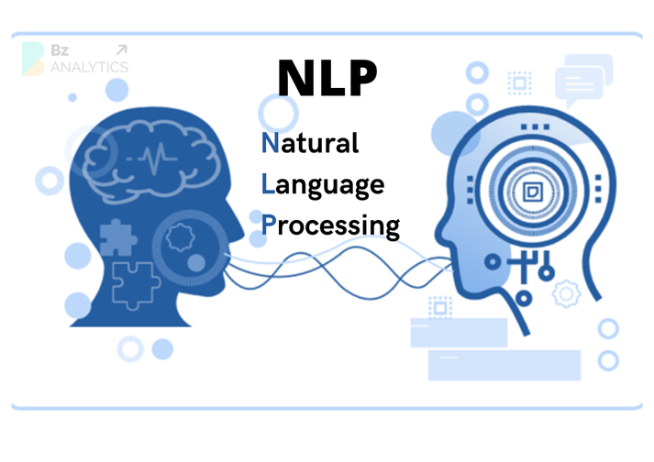
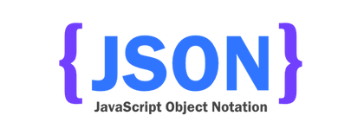


Technologies Used
Programming Language
Python: Python was chosen due to its simplicity, versatility, and support for NLP and Machine Learning libraries. Its concise syntax and readability make it ideal for developing AI applications.
Libraries and Frameworks
PyTorch:
Used for building and training the neural network.
Offers dynamic computation graphs and easy debugging tools.
NLTK (Natural Language Toolkit):
Provides utilities for tokenizing sentences, stemming words, and text processing.
Essential for implementing preprocessing steps in NLP tasks.
NumPy:
Facilitates numerical computations, including array manipulations and mathematical operations.
Integral to the implementation of the Bag of Words model.
Dataset Format
JSON: The dataset containing intents, patterns, and responses was structured in a JSON file. This format ensures ease of data retrieval and modification during development.

Slide 6
Features of the Chatbot
Real-Time Information Retrieval:
The chatbot can fetch the latest course schedules, exam dates, and event information from the department database in real time, helping students stay updated.
Personalized Interaction:
The chatbot understands student-specific queries and tailors responses accordingly, for instance, giving personalized schedules based on the student’s course registrations.
Data-Driven Learning:
The chatbot learns from interactions and feedback, improving its responses over time. The system is trained continuously on new data to refine its accuracy.
Multilingual Support (Future Scope):
The chatbot will support multiple languages to cater to international students or those who prefer non-English interactions.

Slide 7
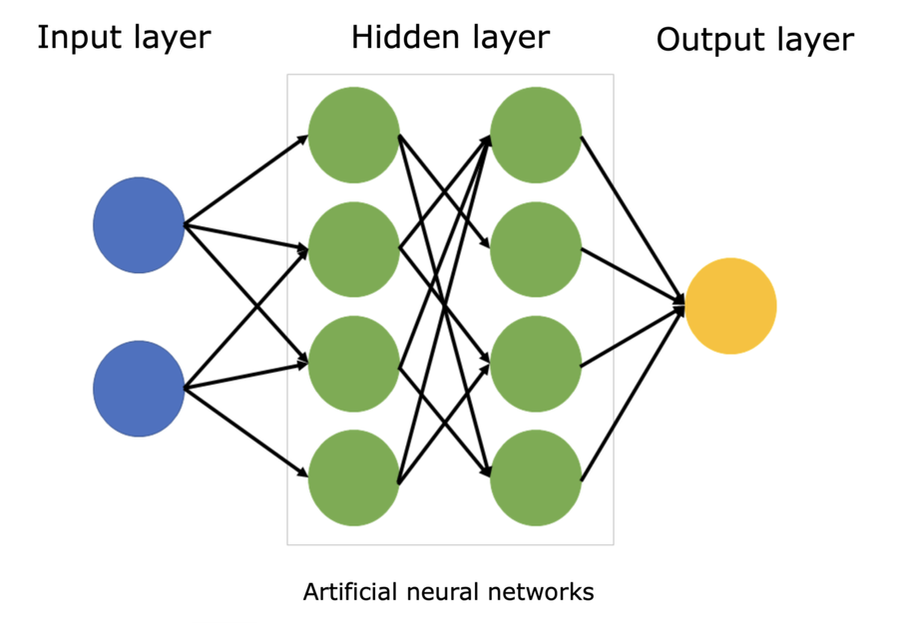
Neural Network Architecture
Model: A simple feedforward neural network implemented using PyTorch.
Input Layer: Takes the bag-of-words vector as input.
Hidden Layer: Applies ReLU activation function for non-linearity.
Output Layer: Outputs the predicted intent label using softmax activation.
Loss Function: Cross-Entropy Loss for classification.
Optimizer: Adam Optimizer for model training.

Slide 8
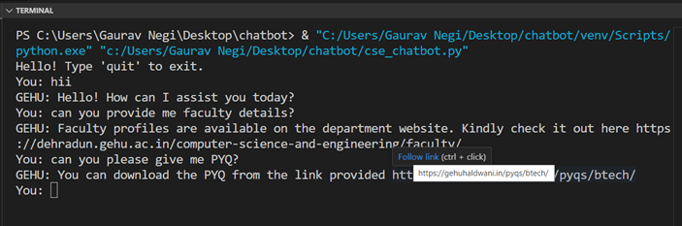
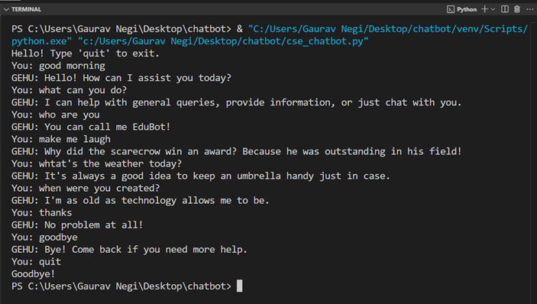
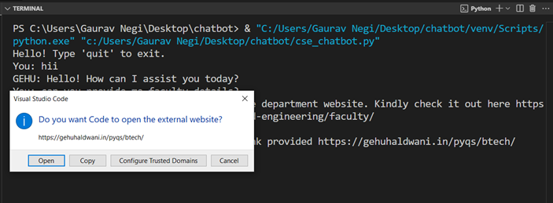
Results
Demonstrated the chatbot successfully answering FAQs during testing.

Slide 9

The chatbot effectively automates repetitive queries, saving time for both students and faculty. It significantly improves access to information, providing real-time and personalized responses.
Future improvements will focus on enhancing voice interaction, multi-language support, and contextual understanding.
• Incorporating more advanced NLP models like LSTM or transformers for better accuracy.
• Integrating real-time data fetching for more dynamic responses.
• Enhancing the chatbot's interactivity with personalized queries and user feedback.
• Next Steps: Deployment in the student portal or as a web app for easy access.
• Adding voice interaction to improve accessibility.
• Expanding the dataset to cover a broader range of queries.
• Supporting multiple languages for diverse users.
• Deploying the chatbot on platforms like WhatsApp, Telegram, or departmental websites.
Conclusion and Future Work

Slide 10
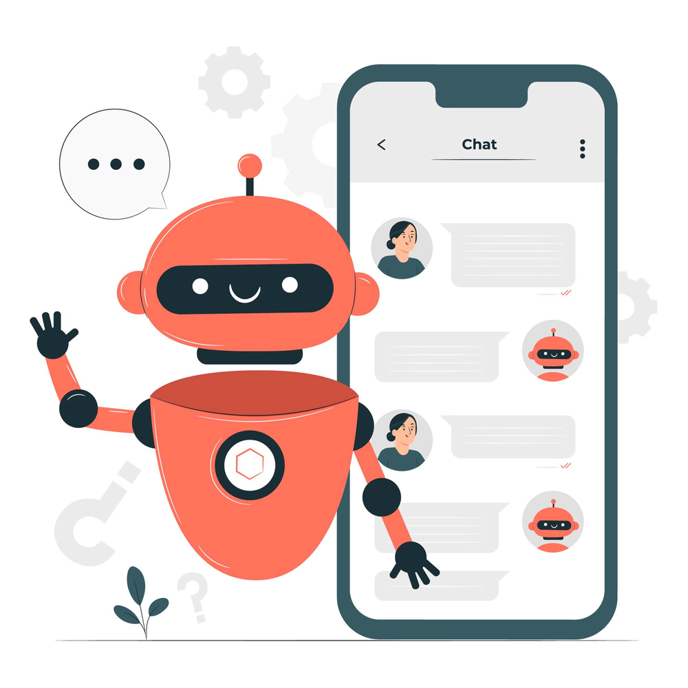
THANKYOU
"The future of technology lies in intelligent conversations."

